Slide 1
Evaluating Public Response of COVID-19 Vaccine using NLP
Kevin Yue
Feb 19, 2021

Slide 2
Motivation of this project
Until Feb 19, 2021, there has been 111 millions covid cases worldwide
Several vaccines has been approved and utilized world wide including two vaccines recently approved by FDA
This project can help government/companies/researchers track people’s options of covid vaccine
(from wiki)

Slide 3
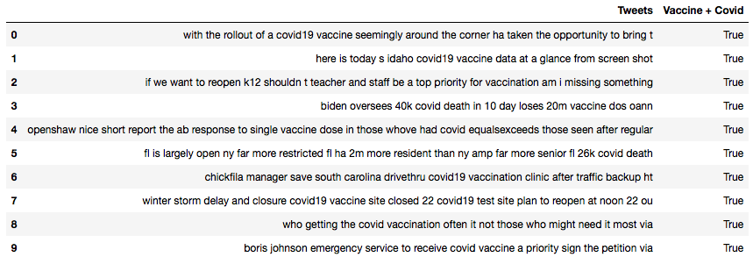
Data Import and Cleaning
Data was obtained from twitter using API
Data was filtered twice to obtain twitter related to covid vaccine
After all cleaning & filtering, 548 tweets were obtained

Slide 4
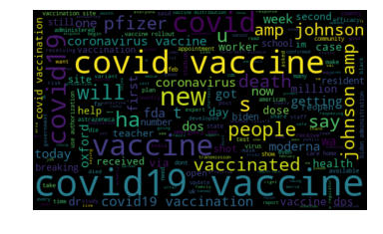
Word Cloud Chart
Tweet content was visualized using word cloud chart, in which the size of word is proportional to its frequency.
The most frequent texts are covid vaccine and covid19 vaccine

Slide 5
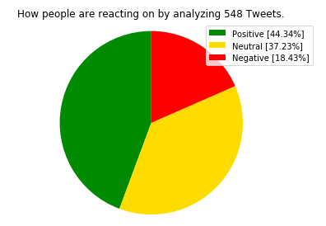
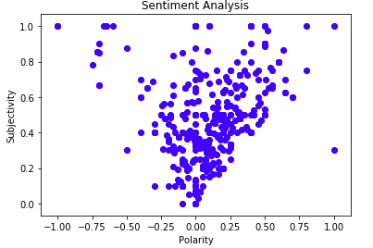
Twitter Sediment Analysis
This analysis was performed using TextBlob function
The results show 44.34% of tweets show positive response of covid vaccine, while the percentages of neutral and negative response are 37.23% and 18.43%, respectively.

Slide 6
Machine Learning 1: SVC to build own sediment model
Support vector classifier analysis was utilized to build own sediment model by training the data with the existing label obtained from TextBlob function.
The results show the an accuracy of 62.42% of own built sediment analysis compared to the TextBlob function
One possible reason for the discrepancy is due to the limited number of tweet for SVC analysis

Slide 7
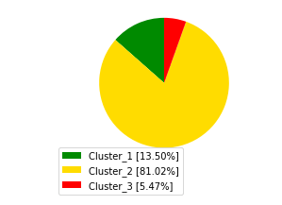
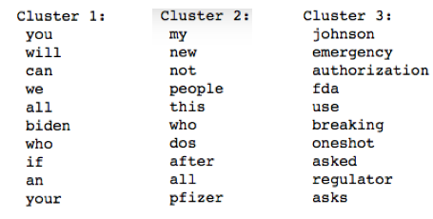
Machine Learning 2: Unsupervised clustering Analysis to Group Tweets
Tweets are first vectorized and then clustered into 3 clusters using KMeans
The percentages of each clusters are 13.5%, 81.02%, 5.47%
The results indicate unsupervised clustering analysis might not be a good way for sediment analysis as the feature words in clusters are not related to options

Slide 8
Summaries
Tweets were obtained from API and filtered twice to obtain the tweets related to covid vaccine.
Twitter sediment analysis was performed by using TextBlob function. The results show that 44.34% of tweets show positive response of covid vaccine, while the percentages of neutral and negative response are 37.23% and 18.43%, respectively.
Support vector classifier analysis was utilized to build own sediment model. The results show the an accuracy of 62.42% compared to the TextBlob function.
The unsupervised clustering analysis was performed to group tweets. Three clusters were obtained with percentages of13.5%, 81.02%, 5.47%, respectively. The results indicate unsupervised clustering analysis might not be a good way for sediment analysis as the unsupervised clustering analysis are not based on options but word frequencies.

